Slide 1
By
K PAVAN KUMAR
Dept. Of CSE
VFSTR University

Slide 2
Predictive Parser

Slide 3
Predictive Parsing
It is a special case of recursive descent parsing where no backtracking is required.
To determine the production to be applied for a non-terminal in case of alternatives.

Slide 4
Input Buffer:
It consists of strings, followed by $
Stack:
It contains a sequence of grammar symbols preceded by $.
Parsing Table:
It is a 2D array M[A, a], where ‘A’ is a NT and
‘a’ is a terminal.
Predictive Parsing Program:
The parser is controlled by a program that considers X(symbol on top of stack) and
a, the current input symbol. These two symbols determine the parser action.

Slide 5
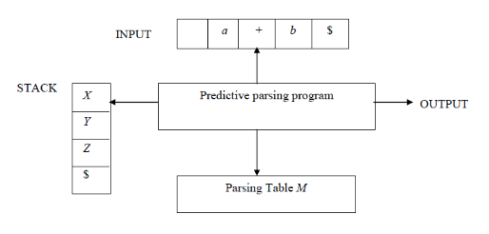
Predictive Parsing

Slide 6
Predictive parsing table construction
The construction of a predictive parser is depends on 2 functions.
1. FIRST
2. FOLLOW

Slide 7
Rules for calculating FIRST( ):
If a production rule X → ∈,
First(X) = { ∈ }
2. For any terminal symbol ‘a’,
First(a) = { a }
3. For a production rule X → Y₁Y₂Y₃,
If ∈ ∉ First(Y₁), then
First(X) = First(Y₁)

Slide 8
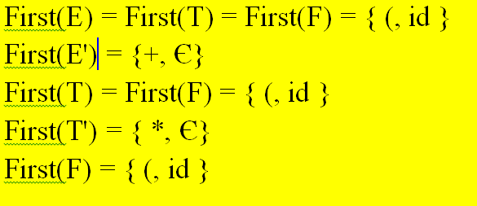
Construct the FIRST(A) of G, E → TE’ , E’ → +TE’|ε, T → FT’, T’ →*FT’|ε, F → (E)|id.
Ans:

Slide 9
Rules for calculating Follow( ):
If S is the start symbol then
Follow(S)={$}
2. if A → αBβ is a production rule then
Follow(B)=First(β) except ε.
3. If ( A → αB is a production rule ) or ( A → αBβ is a production rule and ε is in FIRST(β) ) then
Follow(A) = Follow(B).

Slide 10
Ex: Construct the Follow(A) of G, E → TE’ ,
E’ → +TE’|ε, T → FT’, T’ →*FT’|ε, F → (E)|id.
Sol: Non Terminals(A) are {E, E’, T, T’, F}
Follow(E):
F→(E)
Compare by A→αBβ Where
A = F; α = (; B = E;β = )
By case 1 : Follow(E) = {$}
By Case 2 : Follow(B) = First(β)
∴Follow(E) = First())={)}
Finally Follow(E) = { ),$ }

Slide 11
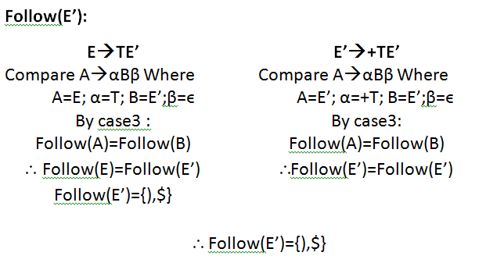

Slide 12
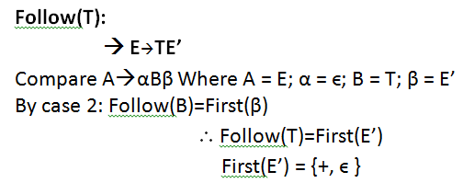
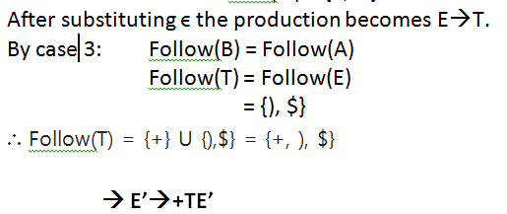



Slide 13
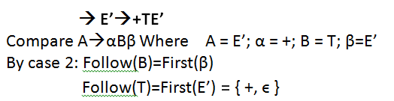
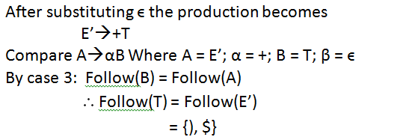


Slide 14
Similarly
FOLLOW(F) = {+, *, ), $ }

Slide 15
Algorithm for P.Parser
Input : Grammar G
Output : Parsing table M
Method :
For each production A → α of the grammar, do steps 2 and 3.
For each terminal a in FIRST(α), add A → α to
M[A, a].
3. If ε is in First(α), add A → α to M[A, b]
Where b = Follow(A).
4. Make each undefined entry of M be error.

Slide 16
Steps for P.Parser:
Elimination of left recursion, left factoring and ambiguous grammar.
Construct FIRST() and FOLLOW() for all non-terminals.
Construct predictive parsing table.
Parse the given input string using stack and parsing table.

Slide 17
Construct the predective parse table for the following Grammar E → E+T|T ,
T → T*F|F, F → (E)|id.
Sol:
Step1:
The given grammar consists of Left Recursion. So we have to eliminate the Left recursion, then the productions becomes
E → T E’
E’ → +T E’ | ε
T → F T’
T’ → *F T’ | ε
F → id | (E)

Slide 18
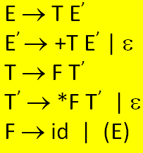
Step 2:
FIRST(E) = { ( , id}
FIRST(E’) ={+ ,ε}
FIRST(T) = { ( , id}
FIRST(T’) = {*, ε }
FIRST(F) = { ( , id }
FOLLOW(E) = { $, ) }
FOLLOW(E’) = { $, ) }
FOLLOW(T) ={ +, $, ) }
FOLLOW(T’)={ +, $, )}
FOLLOW(F)={+,*,$,)}
.

Slide 19








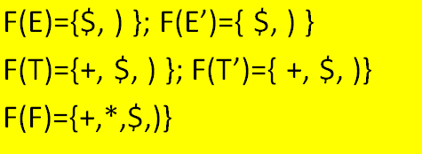
Step 3: Parse Table
 | id | + | * | ( | ) | $
E
E'
T
T'
F

Slide 20
E → TE’ ➔ M[LHS, First(RHS)]
∴ [E ,First(T)] ➔ (E, ( ) and
➔ (E, id)
T → F T’ ➔ M[LHS, First(RHS)]
∴ [T ,First(F)] ➔ (T, ( ) and
➔ (T, id)
E’ → +T E’ ➔ M[LHS, First(RHS)]
∴ [T ,First(F)] ➔ (T, ( ) and
➔ (T, id)
…..
E’ → ϵ ➔ M[LHS, Follow(LHS)]
∴ [E’ ,First(E’)] ➔ (E’, ( ) and
➔ (E’, $)

Slide 21
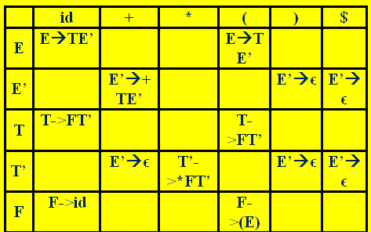
String Acceptance by Parser:
Stack Input Action
$E id+ id* id $ Push E→TE`
$E`T id+ id*id $ Push T→FT`
$E`T`F id+ id*id $ Push F→id
$E`T`id id+ id*id $ pop&remove id
$E`T’ +id*id$ Push T`→€
$E` +id*id$ Push E`→+TE`
$E`T+ +id*id$ Pop&remove +
$E`T id*id$ Push T→FT`
$E`T`F id*id$ Push F→id
$E`T`id id * id$ pop&remove id

Slide 22
…
$E`T` *id$ Push T`→*FT`
$E`T`F* *id$ pop&remove *
$E`T`F id$ Push F→id
$E`T`id id$ Pop&remove id
$E`T` $ Push T`→€
$E` $ Push E`→€
$ $ Parsing is successful

Slide 23
LL(1) Grammars
Whose parsing table has no multiple entries
L L (k) parsing.
Left to Right Scanning
Left-Most Derivation
k lookhead (k is omitted → it is 1)

Slide 24
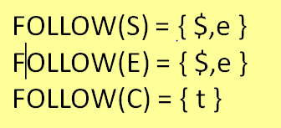
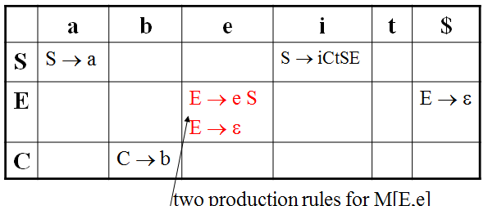
Ex: Verify whether the given grammar is LL(1) or Not.
S → i C t S E | a
E → e S | ε
C → b
FIRST(iCtSE) = {i}
FIRST(a) = {a}
FIRST(eS) = {e}
FIRST(ε) = {ε}
FIRST(b) = {b}
∴ The above grammar is not LL(1) because of two production rules for M[E,e]

Slide 25
Practice problem
Is the grammar G = { S→=R, S→R, R→L,
L→*R | id } an LL(1) grammar?

